Slide 1
Montgomery County Police Autism/IDD (Intellectual and Developmental Disabilities), Alzheimer’s/Dementia Outreach Unit Officer Laurie Reyes Montgomery County Department of Police

Slide 2
The Montgomery County Police Autism/IDD, Alzheimer’s/Dementia Outreach Unit provides a “total approach” to safety and awareness through education, outreach, follow up, empowerment and response.
What began as a way to address calls for “critically at risk” missing persons has since grown to provide resources and support for all types interactions with law enforcement.
Recognized as program model to follow by national advocacy organizations as well as the Department of Justice.

Slide 3
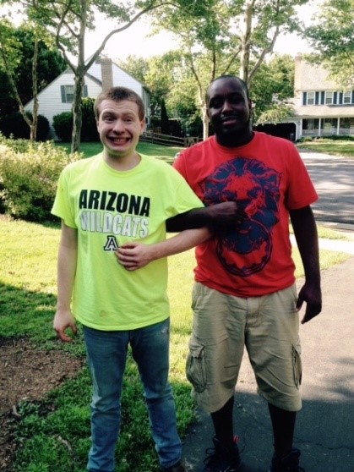
What are we doing to create a safe and supportive community for those who have Autism/IDD, Alzheimer’s/Dementia?

Slide 4
Officer Training
Montgomery County Since 2010
All Incoming Recruits
CIT Officers
ESU Officers
Use of Self Advocates
***We continuously address new challenges and concerns in the Autism/IDD, Alzheimer’s, Dementia communities.
-Increase in age of those who have Autism
-Changes with Health Care Coverage/Care
-Co-occurring conditi
Calls more serious in nature

Slide 5
COMMUNITY EDUCATION AS OUTREACH...
PUBLIC TRANSPORTATION (RIDE ON/METRO SYSTEMS)
SCHOOL TRANSPORTATION (All MCPS have been trained as of 2018)
LOCAL HOSPITALS/NATIONAL HOSPITALS
NURSING HOMES/GROUP HOMES/ASSISTED LIVING FACILITIES
CHAMBER OF COMMERCE
**CAREGIVERS
**INDIVIDUALS

Slide 6
Community Partnerships
Dementia Friendly America, Montgomery County
Alzheimer’s Foundation
Autism Speaks
Down Syndrome Network, Montgomery County
Grows
Adult Protective Services
Child Protective Services
Department of Aging and Disability
Montgomery County Public Schools
Montgomery County Fire Rescue

Slide 7
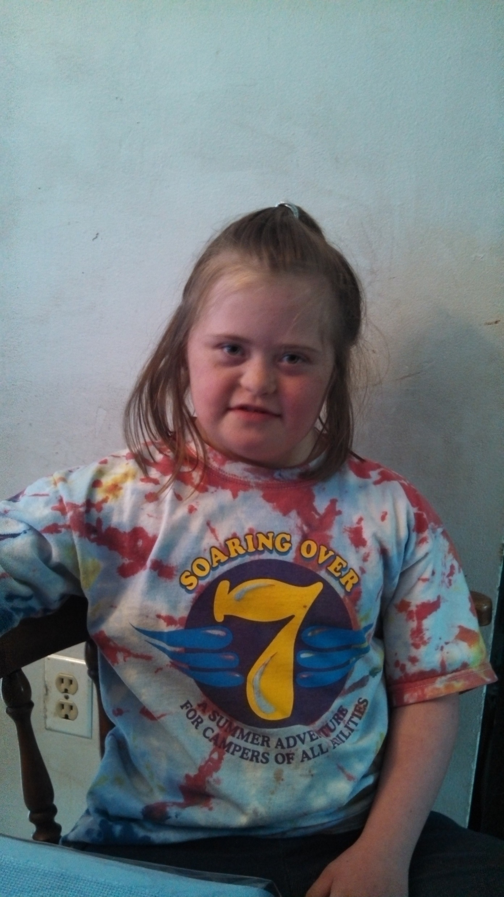
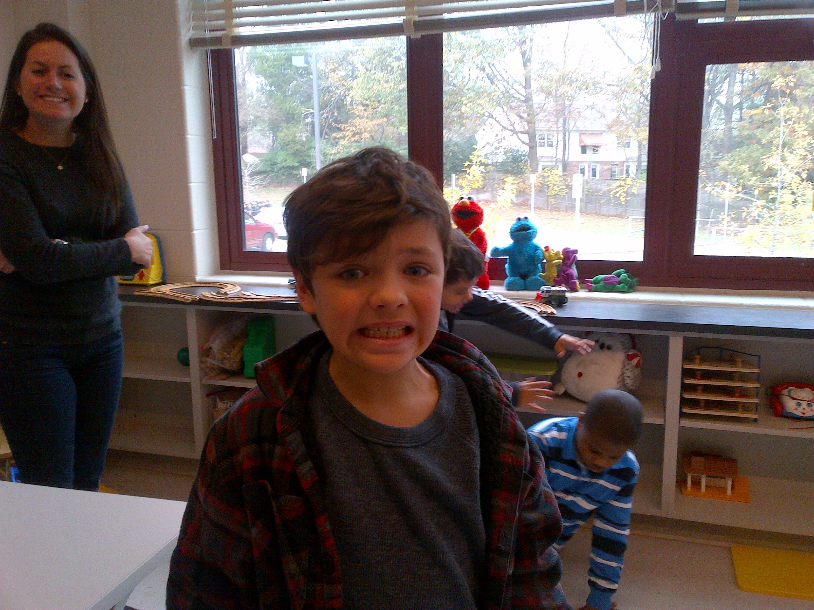
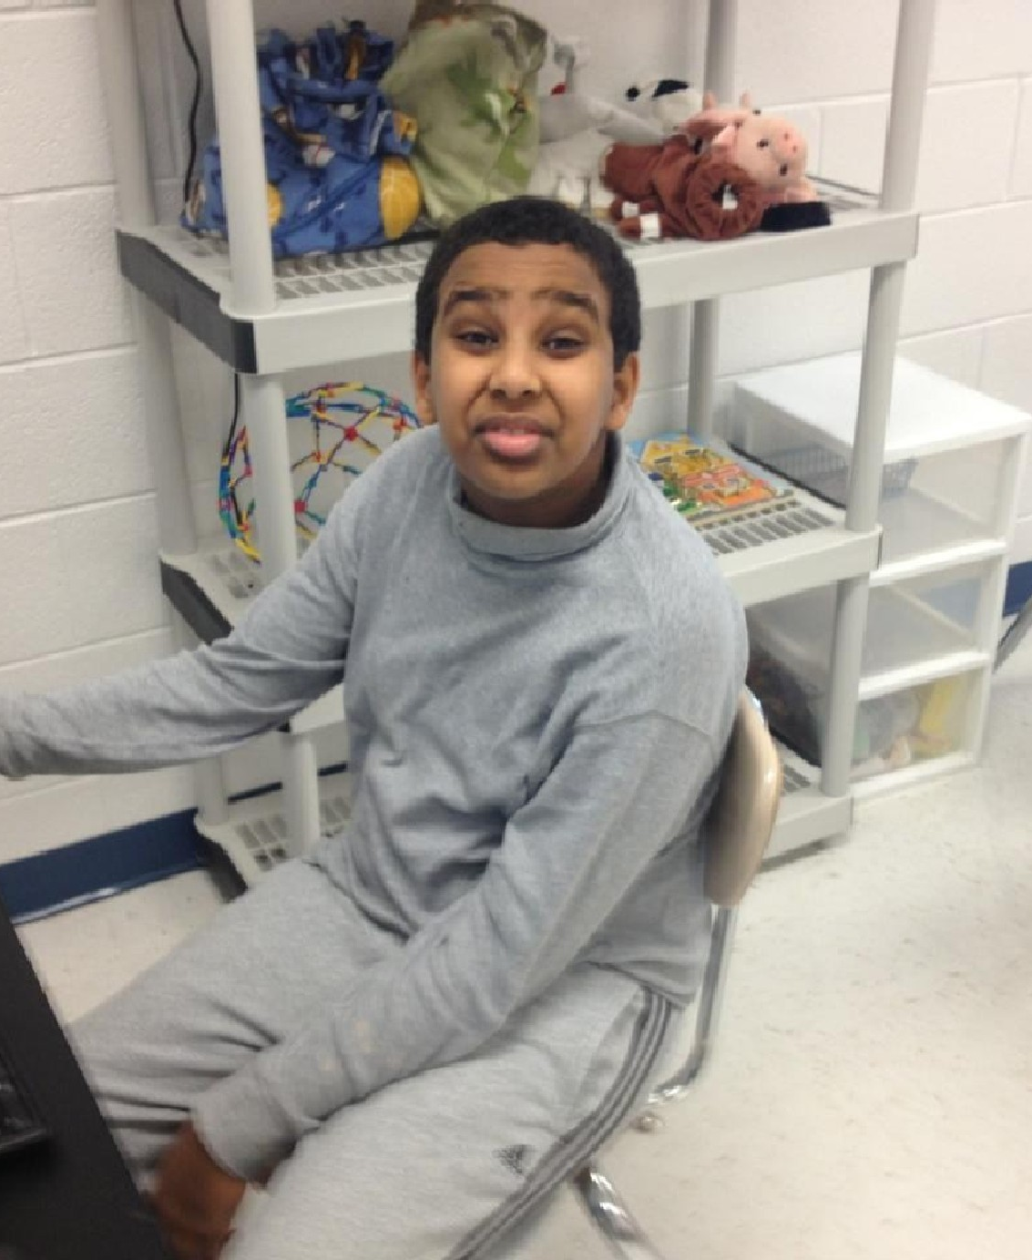
Community Outreach

Slide 8
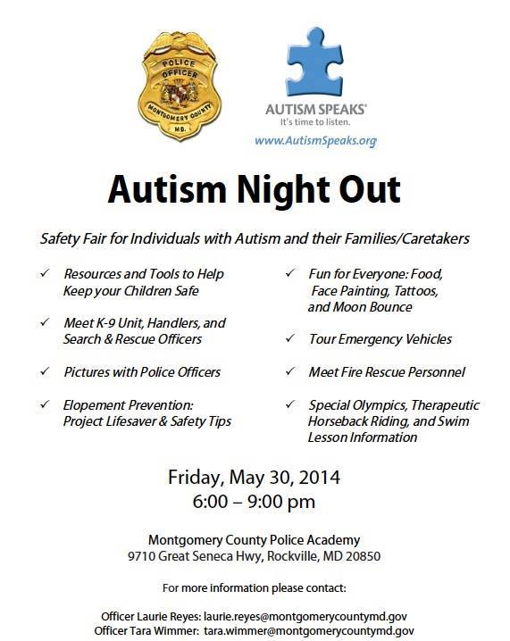
Community Events Education and Understanding Through Exposure… 6th Annual Autism/IDD Night Out (Save The Date) Thursday May 30th (6-9PM) Public Safety Training Academy

Slide 9
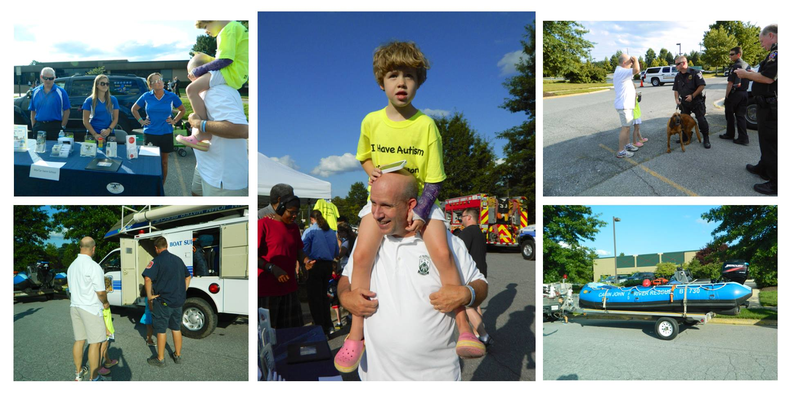

Slide 10
Autism Legislation Local/National ICD-9 House Bill Coverage for “wandering safety tools” Avante/Kevin's Law Ethan’s Law

Slide 11
Media Outreach
Local
(TV, Radio, Department Media Section)
National
(TV, print, radio)
Social Media
(Facebook, Twitter,
Department website
Caregiver/ Self Advocate Participation

Slide 12
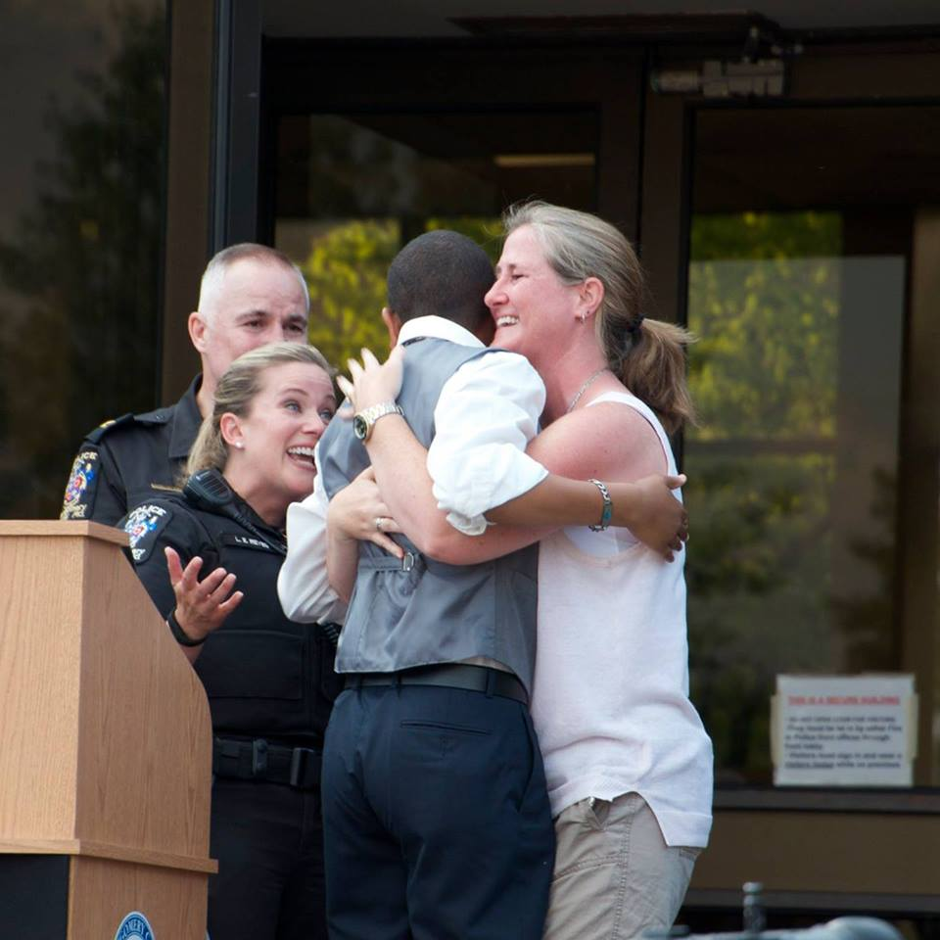
EMPOWERMENT THROUGH CHIEF’S AWARDS AND OPPORTUNITIES
ASSISTING MCPD

Slide 13
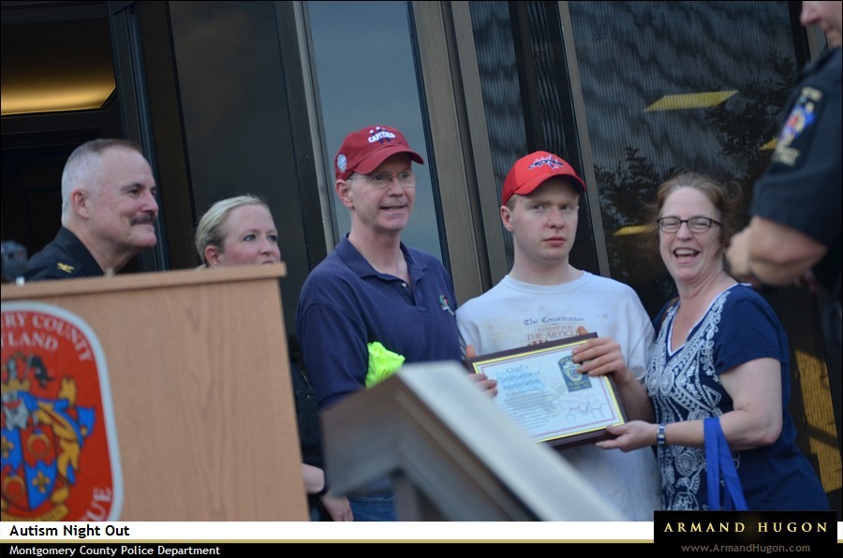
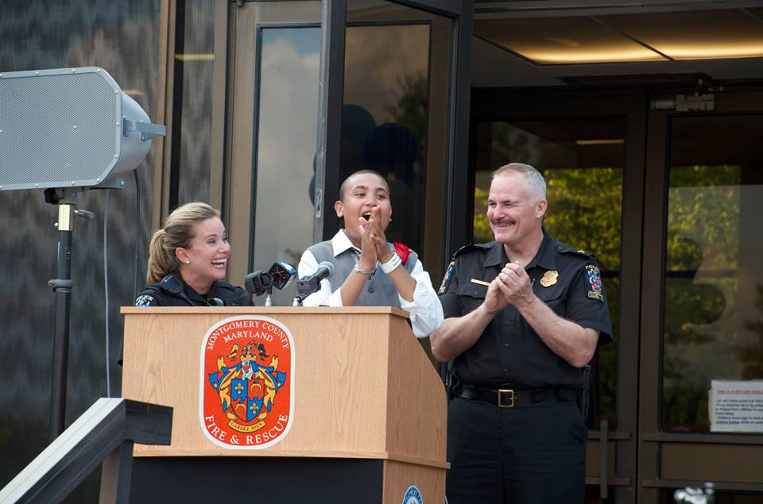
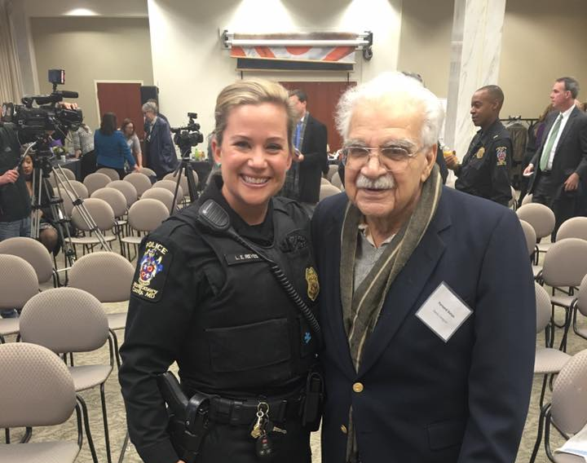
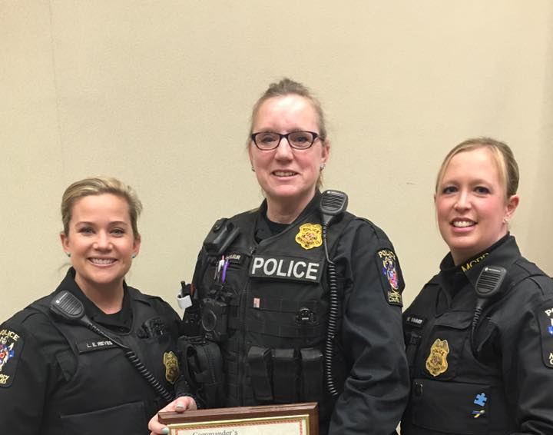

Slide 14
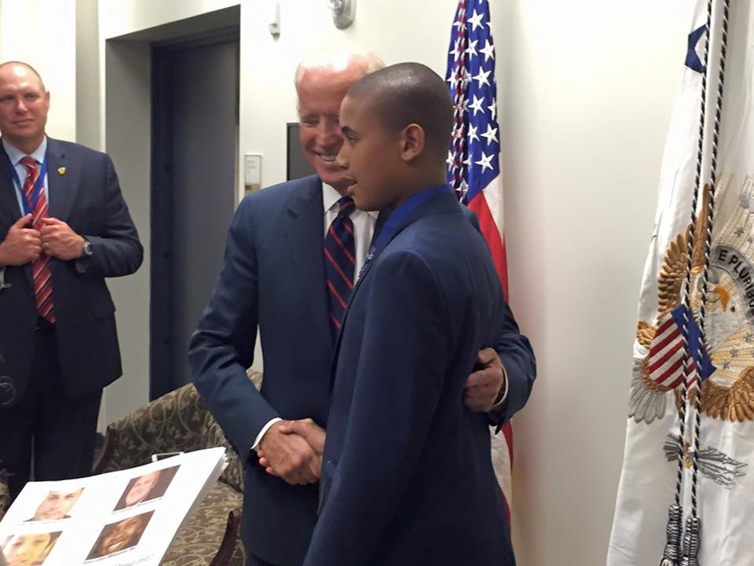
MCPD Autism/IDD Outreach Program receives White House Champions of Change Award for Youth and Law Enforcement MD Governors' Award Attorney General’s Award, Distinguished Service in Policing

Slide 16
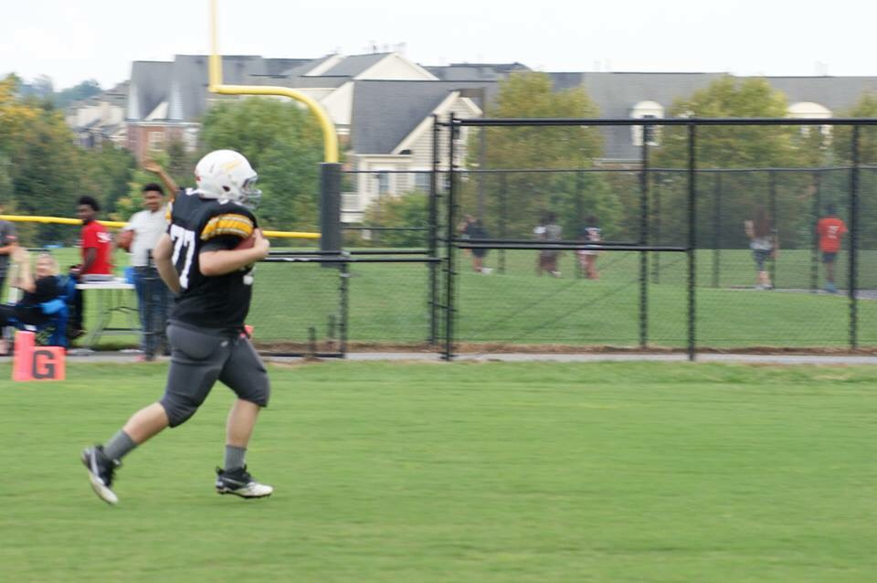
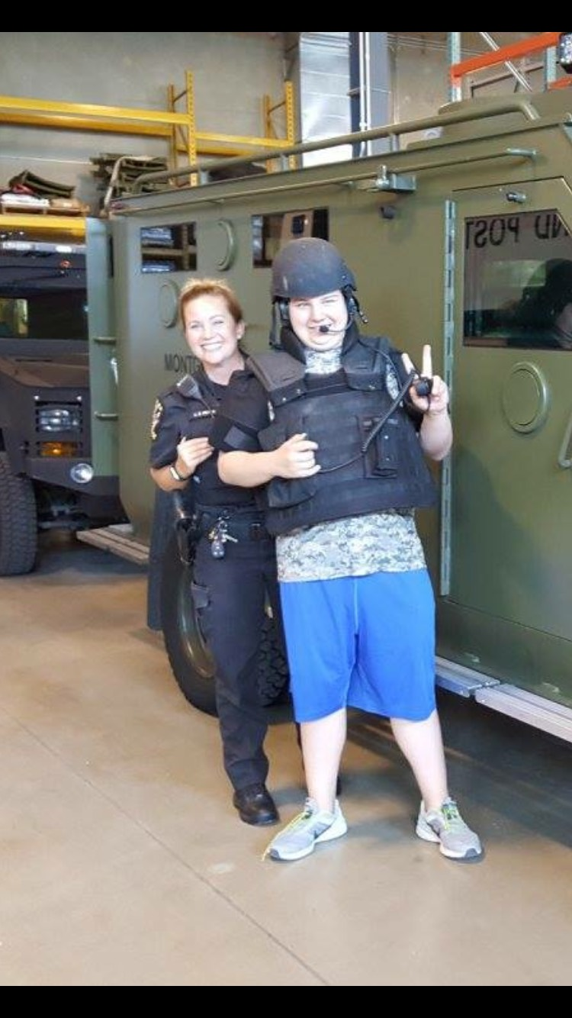
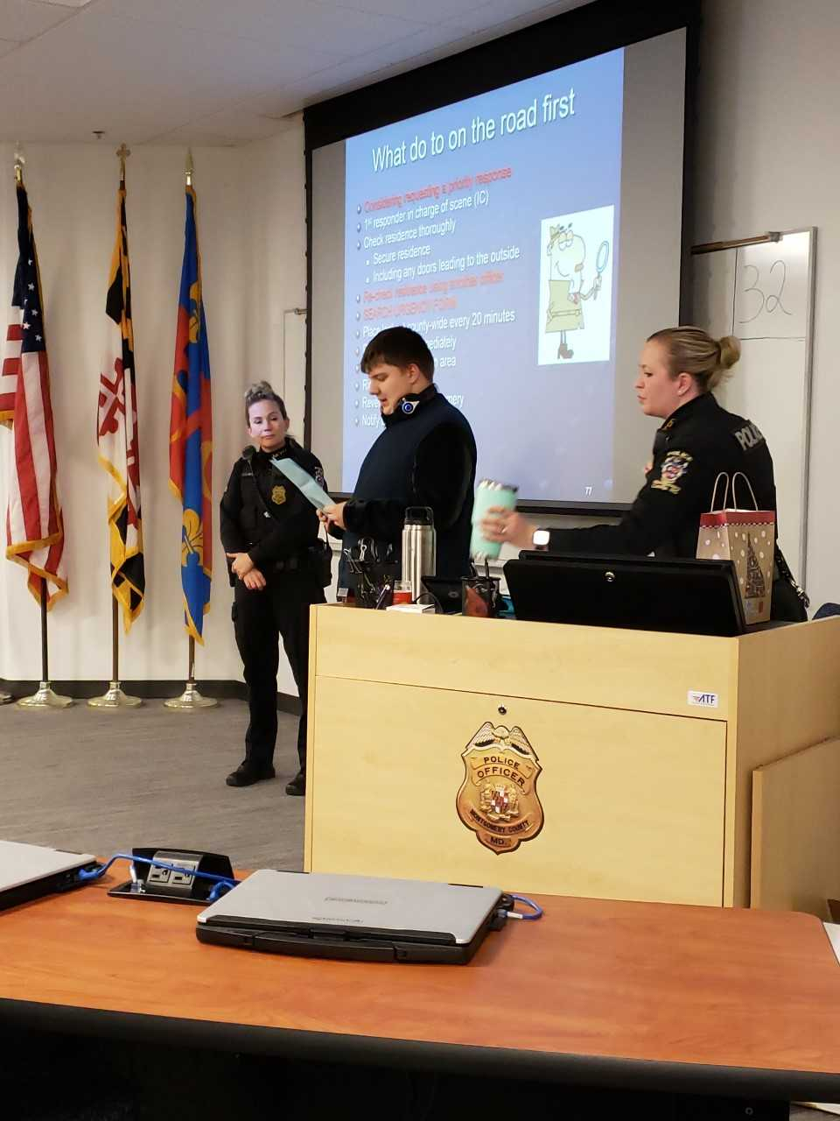
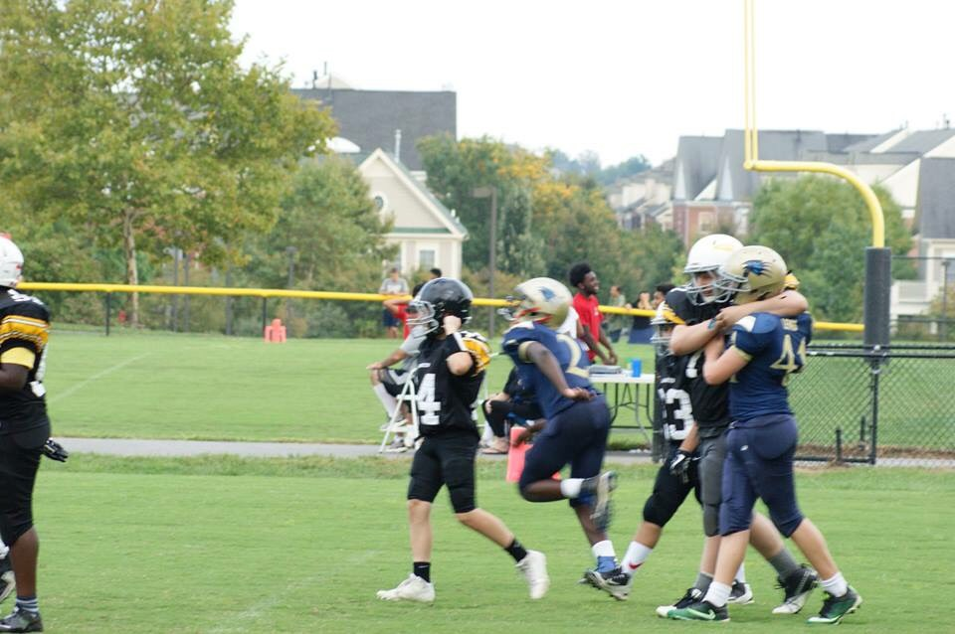
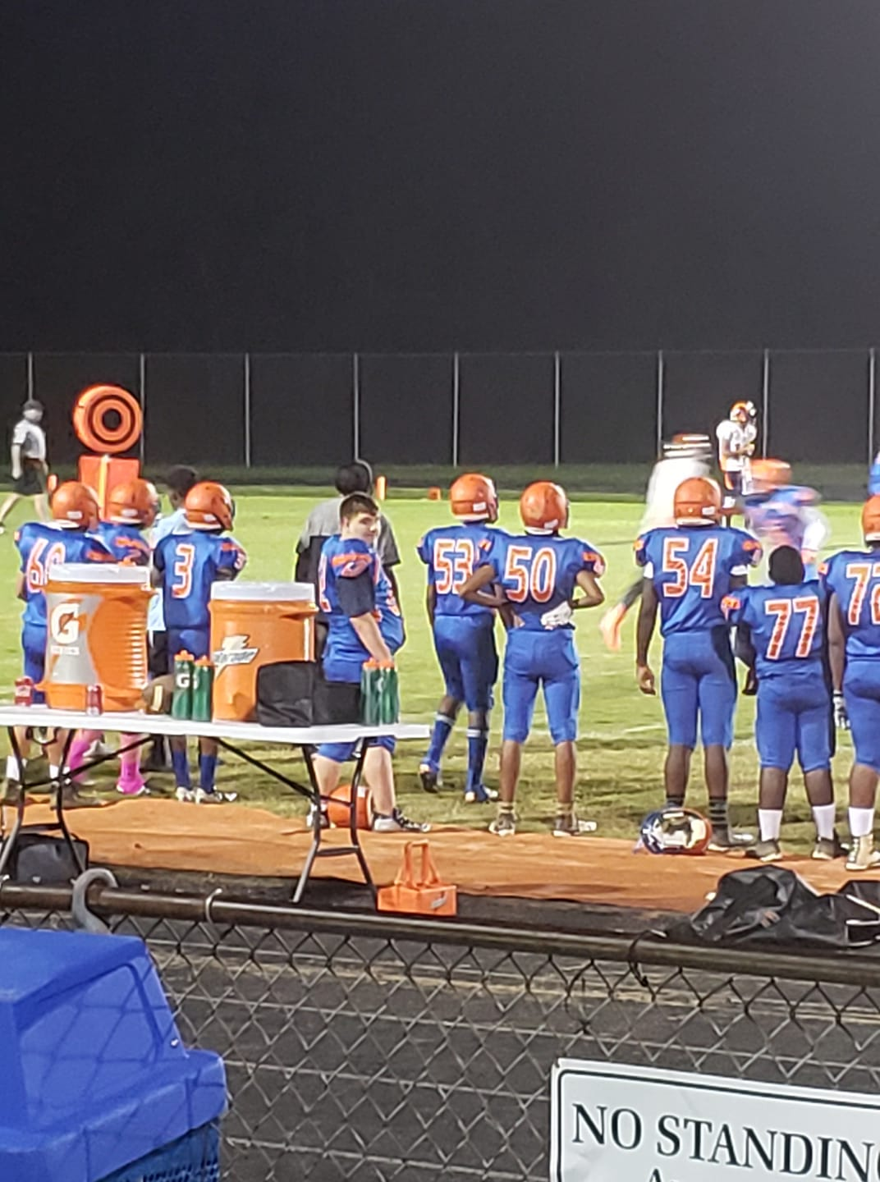
Just had to share… Never Underestimate a person who has Autism/IDD and what they are capable of doing… Be The Voice or Give Them A Voice

Slide 19
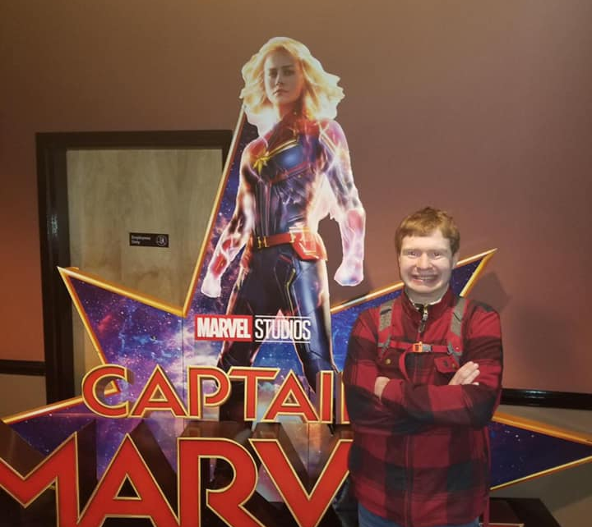
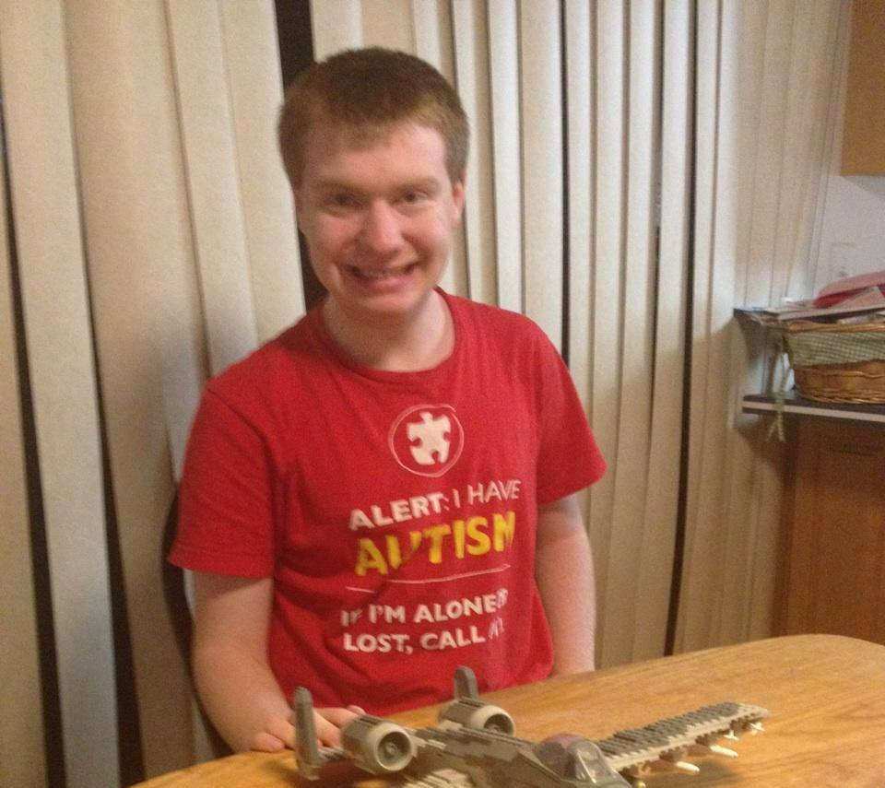
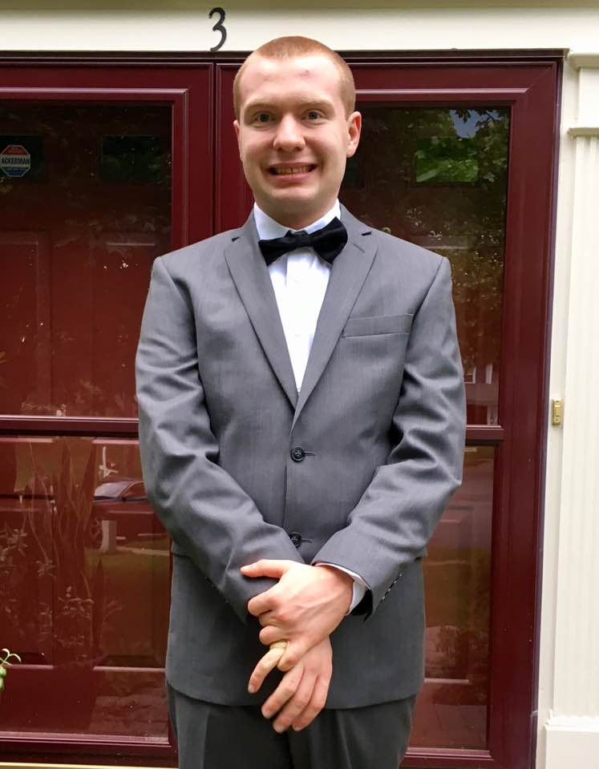
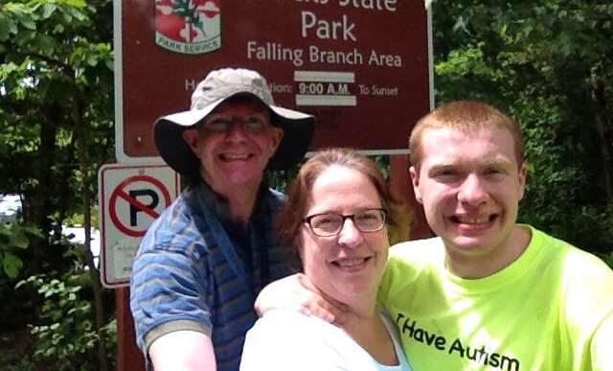
John B. is a young man who...
Loves to go hiking
Smiles in pictures
Loves to swing in a hammock
Loves to put together Legos
Loves to go to the movies
has Autism.
John is very smart
John is very funny
When spoken to in a calm voice, allowing him time to process your request, he will do as ask almost all the time.
John has been the focus of three significant searches in Montgomery County.

Slide 20
EDUCATION OF OUR YOUNG PEOPLE MCPS and Private Schools
FOLLOW the law to be safe
STAY where you are when you meet the police
KEEP your hands to yourself (don’t touch their stuff).
WHEN the police tell you to do something, do it.
TELL the police about your disability.
TELL where you are when you call 911
DON’T run from the police
We provide students with the knowledge that if they feel an encounter was unjust or unlawful, they can absolutely make a formal complaint.
We only ask that they obey the officers instructions at the time of the encounter.
Law Enforcement and Autism/IDD
"Ensuring positive/effective AND safe interactions with Law Enforcement"
The program uses officers experiences as well as the Be Safe curriculum to give the students an extensive overview of how to be safe in the community and have positive interactions with law enforcement.

Slide 21
What should you do when you call 911?
STAY CALM
SAY Where you are
SAY WHO you are “self disclosure”
TELL what happened, why you are calling
TELL if somebody is injured

Slide 22
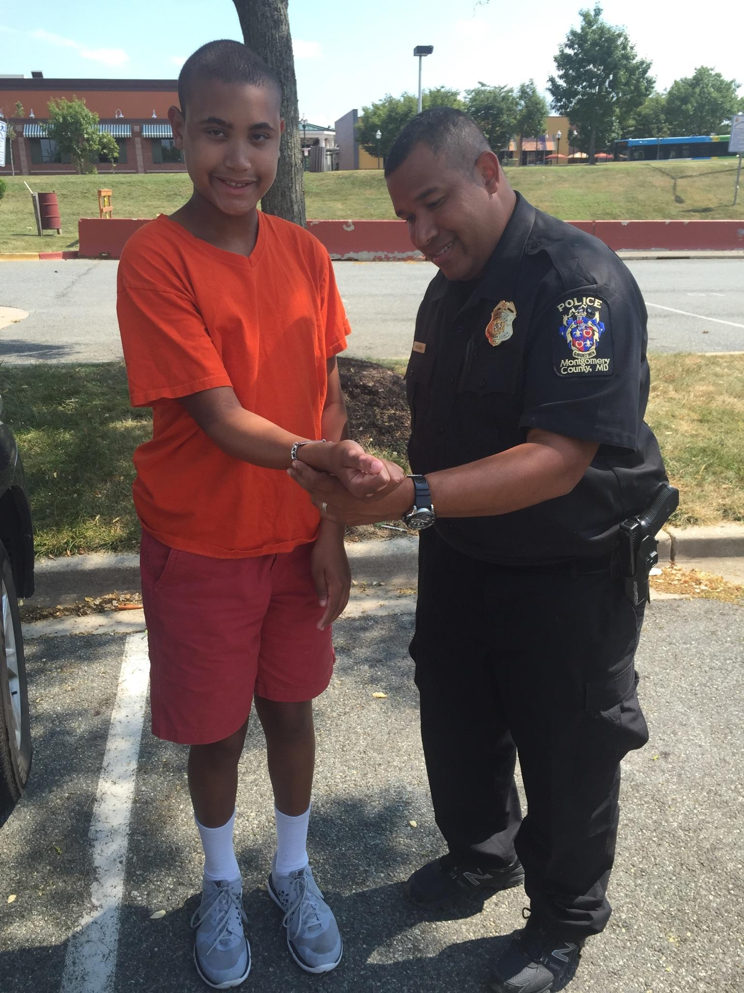
“Officer can I show you my ID Bracelet?” “Can I tell you a little about me?”
ID BRACELETS…
WEIGHING SAFETY VS INDEPDENCE
Why should I have my child get used
to showing an officer their ID bracelet?
There may be “BUMPS”
on the road to
Independence, our job is
to make the bumps navigable.

Slide 23
Wandering/Elopement Concerns… MCPD averages 3-8 "found and or "critically at risk" missing persons a week who have Autism/IDD, Alzheimer's/Dementia
***This total does not include all other "critical at risk" persons in other categories.

Slide 24
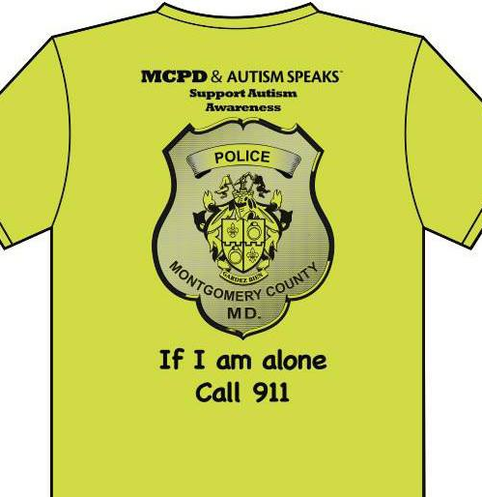
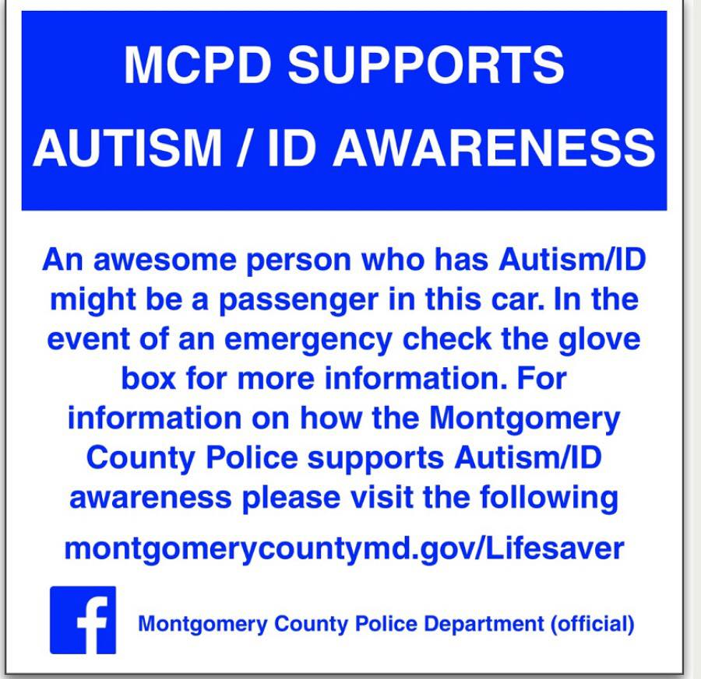
MCPD Wandering Prevention Safety Kit/Safety Shirts These shirts are ONLY designed for those that Can Not Speak for themselves and are at immediate risk! Kit Contents... Window Clings, ID Bracelet, Program brochure, MCPD Sensory toy, stop sign, coordinators contact info

Slide 25
Questions/Concerns??? Program Coordinators Officer Laurie Reyes Laurie.Reyes@Montgomerycountymd.gov Officer Tara Bond Tara.Bond@montgomerycountymd.gov

