Slide 1
Families of Children With Disabilities Program
Special Needs Planning Group
Merrill Lynch
1152 15th Street N.W. Washington DC 20005
202-659-6138
Mark Friese, CRPC. CSNA First Vice President, Wealth Management
Chase Phillips, Financial Advisor
Talya Bock, CFP, CSNA, Financial Advisor
Email: Mark_Friese@ml.com
Fax: 202-609-9374

Slide 2
Families of Children With Disabilities Program
Hello
Notes:
Intro- Merrill Lynch Special Needs Group
How many have heard of it ?
Why it was formed?
What we do to help?
Quarterback of your advocacy team.
How many remember when they first realized that they had a child with special needs?
How did you feel?
Get various responses.

Slide 3
4 Pillars of Special Needs Planning
Government Benefits
Legal Planning
Family Communication
Financial Planning

Slide 4
Government Benefits/Company Benefits
SSI, SSDI, Medicaid,
Medicare
Education of local benefits
such as Medicaid waivers,
Autism waivers, DORS,
employment training, etc.
Local benefits: micro grants,
home share programs, non-profit
benefits

Slide 5
Legal Planning
Wills, Trusts, Special Needs Trusts
Powers of attorney
Medical directives
Tax planning
Gaurdianship and alternatives to
guardianship

Slide 6
Family Communication
Family Education
Letters of intent
Beneficiary designations
Special needs workbook

Slide 7
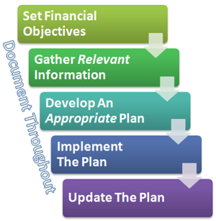
Financial Planning
Cash flow planning and funding the special needs trust
Permanent life insurance
Investment management
529 ABLE accounts

Slide 8
Life Style Pressing questions-
Who will take care of and watch over our child after we are no longer able to do so?
Will there be adequate financial resources to maintain a decent quality of life for our child?
What about a dedicated team to help?
Medical
Advocacy
Living arrangements
Legal
Notes:
These are often the most pressing questions families of children with disabilities ask themselves.
The cliff of no more supported programs

Slide 9
Lifestyle Why families with special needs family members are unique
Your lifestyle should take into account not only your future, but your child’s as well.
So you are planning for two lifetimes.
This type of planning requires specialized expertise.
Leave behind a road map.
Notes:
Two lifetimes of planning
Specialized expertise
Roadmap- letter of intent
Your wishes for your child
Child’s wishes
Special things to know
Medical Needs
Living arrangement preferences
Professional contacts

Slide 10
Life Style Questions
How would your child’s quality of life change if you no longer provided these funds?
How much of your total estate would you need to leave behind for your child’s care?
How confident are you in your own retirement plans, that you are on track?
Notes:
What about blended families?
What about siblings? Can and will they help?
Needs are often not equal.

Slide 11
Preparing for the future
Have you made adequate preparations for your child’s lifetime care?
Few families of children with disabilities have a financial strategy in place today.
The consequences for a child with a disability could be tragic if families aren’t prepared.
Parents are getting older, and many persons with disabilities are still living at home.
Notes:
The sooner you begin to prepare, the sooner you can start to feel confident and assured about the security of your child’s future.

Slide 12
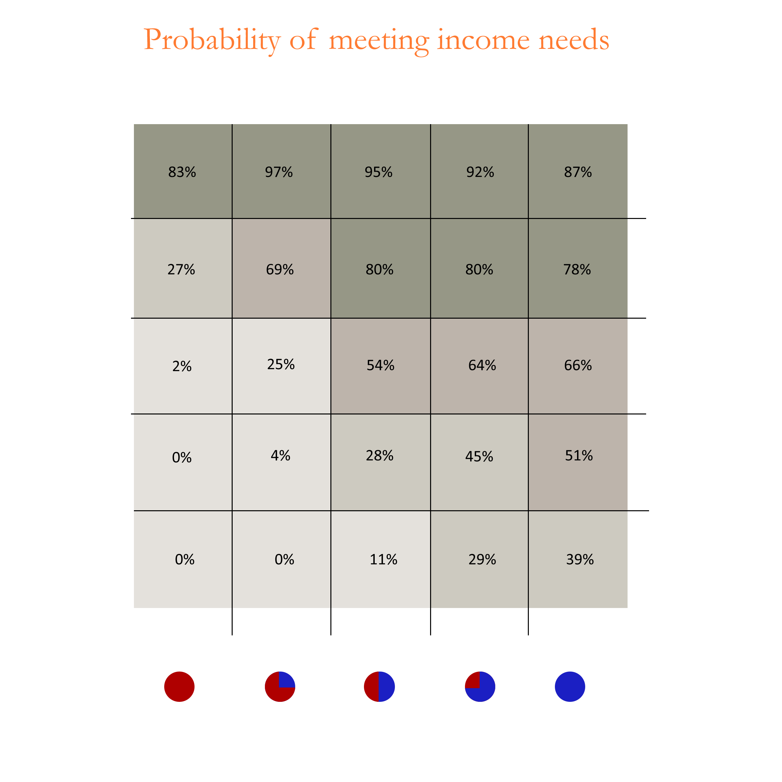
How much is enough?
Notes:
5% withdrawal rule
Diversification to reduce risk
Current interest rate environment

Slide 13
Finding Gold For Special Needs Families
Potential resources
Family
Current assets
401(k)
Insurance
Investments
Grants
Waivers
Government programs
SSI
ABLE
Notes:
Family can help
Education for family to protect government benefits
Legacy ideas for grand parents
Grants
Autism Society
Autism Speaks
ARC
Many others
Waivers
Respite care
Housing
Long waiting period

Slide 14
How many feel overwhelmed ? “On your own” approach
Trustee
Care Manager
Attorney
Parents/Guardians
Trust Company
Residential Coordinator
Insurance Agent
Financial Advisor
Notes:
Many families are reluctant to begin the planning process because it’s simply too overwhelming for those who already have little or no time to spare. Too busy
Scared to make the wrong choice.
Don’t know where to start.
Not sure what you really need.

Slide 15
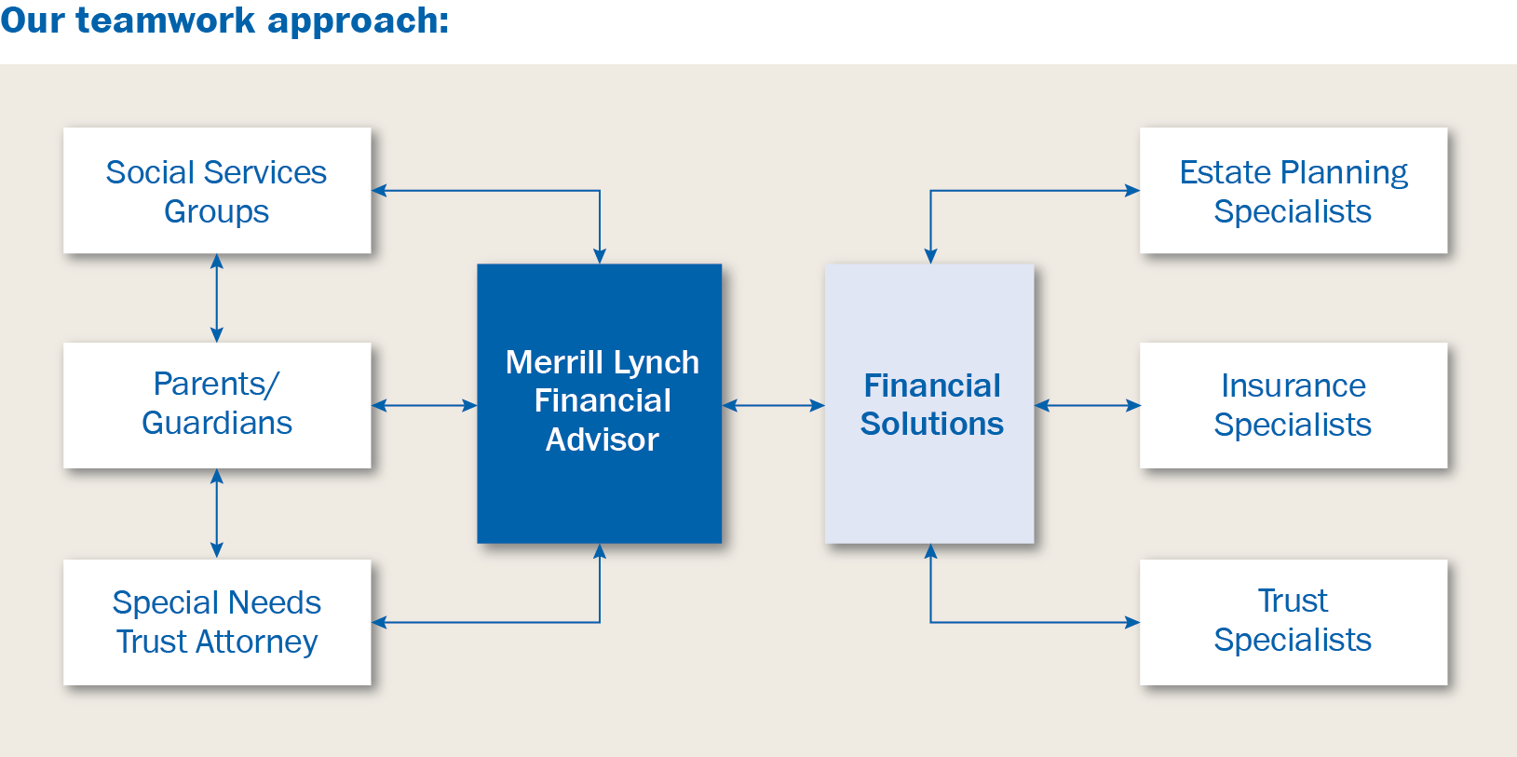
Teamwork approach

Slide 16
A family-focused strategy
A good financial strategy can be the foundation of your financial success.
Including the entire family can make the process harmonious and beneficial for all.
Include the team in the decisions.
Start as early as possible.
Notes:
Include all of your professionals
Lawyer
Health Care
Financial
Accountant
The power of compounding.
Many of the solutions are less expensive when you are younger.

Slide 17
Financial Needs
Special Needs Calculator (page 13)
Expected income from child
Projected expenses for child
Parent’s number of year until retirement.
Projects years of income for child with special needs.
Project life expectancy of child with special needs.
Worksheet (page 14-15)
Notes:
Go over calculator
Go over worksheets

Slide 18
Financial Needs
Do you work with a professional?
Does that professional know you have a child with special needs?
Were those needs taken into account in your planning?
Notes:
The guy in the yellow hat might not be good at helping you with your finances.
You should work with someone that knows the special needs world
You should make sure that they are educated in financial planning for person with special needs. CFP, CSNA, CRPC.

Slide 19
Financial Needs
Do you understand the fees that you are paying for asset management?
Are your goals clearly articulated?
Are you on track to reach your goals?
Are you aware of alternative funding options for future needs?
Notes:
How many people own mutual funds
Mutual funds verses indexes
Hard to reach goals without a clear plan
Bringing all professional together to help you.
Other funding options

Slide 20
Get Organized
Beneficiary checklist
Don’t assume anything
Educate outside family
Understand how different assets will pass to the next generation.
Notes:
Beneficiary check list (page 12)
Tell story of husband who had ex-wife as beneficiary
Asset for persons getting benefits can’t pass to them directly without issues

Slide 21
Get Started Now
Waiting can create significant issues.
Waiting can cost you money.
Waiting might make you ineligible for some funding options.
Waiting is not fair to your family.
Notes:
Take action
Assess your situation
Call for help

Slide 22
Potential Pitfalls
Notes:
Take action
Assess your situation
Call for help

Slide 23
Questions
Notes:
Initial consultation is complimentary
Thank host

