Slide 2
College Living Experience:
Preparing your High School Student for the Transition to College
Live. Engage. Achieve.
800.486.5058 | ExperienceCLE.com

Slide 3
Beyond Academics
Strategies to Prepare for Success after High School:
High School is the time to build foundational skills in:
Executive Function
Self-Advocacy
Social Skills
Independent Living Skills
Live. Engage. Achieve.
800.486.5058 | ExperienceCLE.com

Slide 4
Participant Outcomes
You will learn:
What is Executive Function?
What are some strategies to address Executive Function?
Why is Self-Advocacy important, and how can we promote it?
How do college supports differ from high school?
Social skills to practice in high school
Independent living skills to practice in high school
Live. Engage. Achieve.
800.486.5058 | ExperienceCLE.com

Slide 5
What is CLE?
A post-secondary program that provides:
Temporary support in transition to life after high school while pursuing academic interests
Assistance in areas that commonly affect success for college students, including living and social supports
Guidance to meet goals
Live. Engage. Achieve.
800.486.5058 | ExperienceCLE.com

Slide 6
Where are we?
Live. Engage. Achieve.
800.486.5058 | ExperienceCLE.com

Slide 7
Why Do We Do It?
25% of students at CLE have previously tried college & determined more support was needed
Students lack exposure to the higher education model, systems, and culture
Independent living and social skills influence classroom success
Self-determined students are most likely to live outside of their parents’ home successfully
Live. Engage. Achieve.
800.486.5058 | ExperienceCLE.com

Slide 8
What Do We Do?
We meet you where you are, providing individualized post-secondary instruction and guidance in:
Academics
Social Skills
Independent Living Skills
Career Development
Live. Engage. Achieve.
800.486.5058 | ExperienceCLE.com

Slide 9
Backwards Planning for Future Goals
Backwards Planning/Backwards Design – concept in curriculum development by McTighe and Wiggins.
Thinking Backwards:
What is the end goal?
What assessment will show the goal has been met?
What are the steps that the student will need to get there?
Live. Engage. Achieve.
800.486.5058 | ExperienceCLE.com
Notes:
McTighe and Wiggins came up with the concept of Backwards Design, a method of designing educational curriculum by setting goals before choosing instructional methods and forms of assessment. Their thee steps are: identify the results; determine acceptable levels of evidence that support that the desired results have occurred; design activities (learning events) that will make desired results happen. By contrast, typical curriculum development would start with activities/teaching methodology and build out from there.

Slide 10
Backwards Planning Independent Living Skills
What is the end goal? To leave my student home alone while I go to dinner and see a movie
What assessment will show that he can meet the goal? Staying home alone safely for increasing amounts of time
What are the steps he will need to get there?
Know how to lock the doors and know who should/shouldn’t be let into the home
Know how to answer the phone appropriately and how much information to give out
Know how and when to call parents and 911
Be able to spend unstructured, unsupervised time appropriately
Live. Engage. Achieve.
800.486.5058 | ExperienceCLE.com

Slide 11
Activity
Choose a non-academic goal for your student, and use backwards planning to plot out the steps to get there. Be ready to share!
Live. Engage. Achieve.
800.486.5058 | ExperienceCLE.com

Slide 12
Strategies for the “Steps to Get You There”
This presentation is “backwards-planned” – we’ve seen how we want to set goals; now let’s learn what strategies can help with the steps to meet those goals.
Steps towards goals of independence will naturally encompass:
Executive function strategies
Self-Advocacy strategies
Social Skills strategies
Independent Living Skills strategies
High school is the time to practice!
Live. Engage. Achieve.
800.486.5058 | ExperienceCLE.com

Slide 13
What is Executive Function?
Time Management
Multi-tasking
Planning and Organizing
Initiating and Maintaining
Metacognition
Live. Engage. Achieve.
800.486.5058 | ExperienceCLE.com

Slide 14
Strategies for Executive Function
Organizing Space:
Decrease clutter in work area
Work in a designated space
Reduce distractions independently based on understanding of needs
Organizing Time:
Use a visual schedule/to-do list
Technology (match to learning style and needs)
Practice time management with guessing games
Chunk assignments into manageable parts with timelines for completion
Plan for breaks
Live. Engage. Achieve.
800.486.5058 | ExperienceCLE.com

Slide 15
What is Self-Advocacy?
A brief definition of self-advocacy:
Acknowledge that you need help
Ask for help appropriately
Accept help
Live. Engage. Achieve.
800.486.5058 | ExperienceCLE.com

Slide 16
Strategies for Self-Advocacy
Help your student:
Understand their disability, as well as their strengths
Recognize appropriate times for disclosure
Learn rights and responsibilities when it comes to accommodations
Work through problem solving skills; practice ways to ask for help
Normalize their disabilities – everyone has a cluster of strengths and weaknesses
Live. Engage. Achieve.
800.486.5058 | ExperienceCLE.com

Slide 17
Social Skills to Practice in High School
Understanding non-verbal communication (including tone of voice)
Introductions in a social setting – generalization for variations; reciprocity
Collaborative communication (relates to Common Core, post-secondary classes, and to the workforce)
Accepting “no” for an answer
Planning/initiating a leisure activity
Live. Engage. Achieve.
800.486.5058 | ExperienceCLE.com

Slide 18
Independent Living Skills to Practice in High School
Waking up independently, setting and using an alarm
Using organizational tools, such as a daily/weekly calendar system
Personal hygiene (is it a problem of motivation or sensitivity?)
Knowing how to exit home in case of emergency/knowing when and how to make calls for emergency services
Knowing how to secure doors and windows
Basic meal preparation; light housekeeping
Using public transportation, or being exposed to it
Live. Engage. Achieve.
800.486.5058 | ExperienceCLE.com

Slide 19
Differences Between High School and College
Student with a disability:
Has a physical or mental impairment which substantially limits one or more major life activities; or has a record of such impairment; or is regarded as having such impairment.
Qualified student with a disability:
Student with a disability who meets the academic and technical standards requisite for admission or participation in the college’s education program. In other words, attending college is not an entitlement.
Live. Engage. Achieve.
800.486.5058 | ExperienceCLE.com
Notes:
Consider removing all this text in favor of explaining. Or highlight the changes. This is a lot to read through in one slide

Slide 20
Differences Between High School and College
Different laws apply, which means the student is moving from entitlement to equal access.
IDEA is a federal statute that entitles a student with a disability who meets the law’s requirements to Free and Appropriate Public Education (FAPE) through high school graduation or age 21, whichever comes first.
Section 504 of the Rehabilitation Act of 1973 and the ADA are anti-discrimination laws. They are the laws that apply to college accommodations (as well as K-12 accommodations for those students who don’t meet the standards for an IEP).
College students must take charge of applying for disability support and informing their professors of their accommodations.
Live. Engage. Achieve.
800.486.5058 | ExperienceCLE.com

Slide 21
Differences Between High School and College
What has the student become accustomed to under an IEP?
School districts identify students with disabilities and evaluate in all areas of suspected disability
Annual goals to measure progress; school districts must show progress
Case manager to facilitate communication between student and teachers, and between home and school
Direct instruction in areas of need, which may include organizational skills, as well as social skills and self-advocacy
Accommodations automatically given in class and in testing situations
Live. Engage. Achieve.
800.486.5058 | ExperienceCLE.com

Slide 22
Differences Between High School and College
What happens in college?
Students must self-identify and notify the college through the college’s Disability Support Office.
Students receive a letter outlining their accommodations. Letters must be hand delivered by the student to each of their professors.
According to the Office of Civil Rights, approximately 50% of college students with a disability do not self-identify.
Live. Engage. Achieve.
800.486.5058 | ExperienceCLE.com

Slide 23
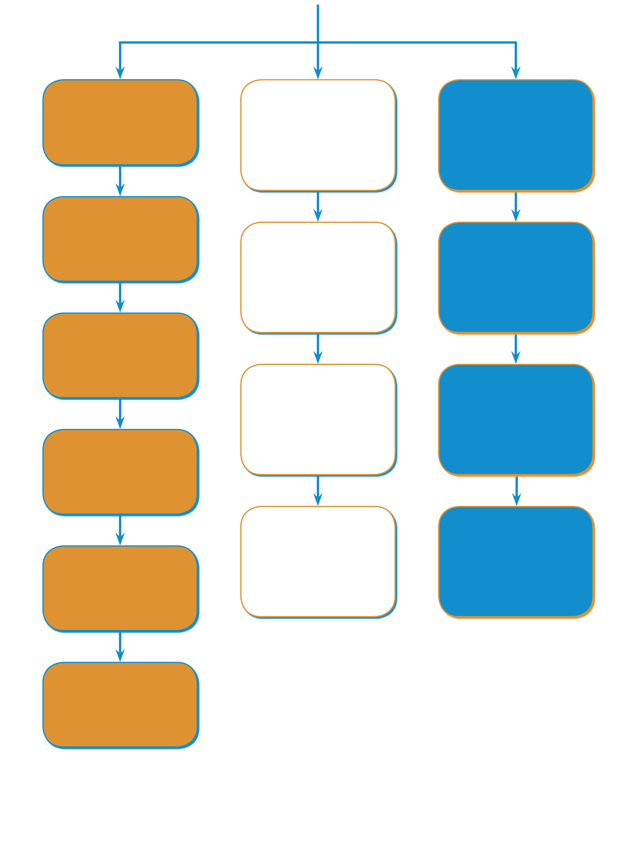
Roles and Responsibilities in College
Student Responsibilities
Disability Support Services Responsibilities
Faculty Responsibilities
Register with DSS
Determine eligibility for services
Provide accommodations on accommodation letter
Provide current documentation
Authorize appropriate academic accommodations
Respect student privacy
Discuss accommodation needs with coordinator
Assist faculty with regard to disability specific issues
Questions about accommodations? Contact DSS
Give accommodation letter to professors
Questions about accommodations? Contact DSS
Communicate with faculty as needed
Going to College • VCU-RRTC • www.going-to-college.org
Live. Engage. Achieve.
800.486.5058 | ExperienceCLE.com
Communicate with faculty as needed

Slide 24
Typical College Accommodations
Extra time and/or computer for exams
Class notes
Accessible class materials
Assistive Technology in class
Document conversion
Interpreters and services for deaf and hard of hearing students
Reader/Scribe for classes, exams, and/or library research
Priority Registration
Full time status granted for part-time course load
Live. Engage. Achieve.
800.486.5058 | ExperienceCLE.com

Slide 25
What is NOT Required by Colleges?
Colleges do not have to change any academic requirements that:
Are essential to instruction
Are necessary for licensing requirements
Alter the fundamental nature of a program
Present undue financial or administrative burdens
Are not considered reasonable*
Accommodations are not required to produce identical result or level of achievement; but must afford equal opportunity to obtain the same result, gain the same benefit, or reach the same level of achievement.
*OCR gives appropriate deference to the academic discretion of a college
Live. Engage. Achieve.
800.486.5058 | ExperienceCLE.com

Slide 26
Academics in the College Setting
Factors to consider:
USE ACCOMMODATIONS
Is a full course load necessary?
What is a syllabus?
Rule of thumb: 1:3 (three hours of studying for every hour of class)
Tutoring assistance
Office hours for professors
CHECK YOUR EMAIL!
Live. Engage. Achieve.
800.486.5058 | ExperienceCLE.com

Slide 27
How to Prepare for the Transition
What Affects Success:
Self-selection of time (scheduling and executive function)
Personal hygiene
Self-Advocacy skills
Independent Living Skills
Self Care
Advocacy
Academics
Independent
Living
Live. Engage. Achieve.
800.486.5058 | ExperienceCLE.com
Notes:
Made this in to bullets and added a visual I had on this

Slide 28
How to Prepare for the Transition
Strategies to use in high school:
Practice self-advocacy with high school teachers
Use executive function strategies to manage assignments independently
Use accommodations to empower rather than enable (ex: how to use extra time correctly)
Have student take responsibility for waking up with an alarm clock, getting dressed independently and appropriately for the weather, making own breakfast
Begin teaching about money management and medication management
Don’t shy away from natural consequences
Live. Engage. Achieve.
800.486.5058 | ExperienceCLE.com

Slide 29
Questions?
There are many curves ahead, and life after high school can be a little like a roller coaster; scary, fast, exciting, and hopefully fun!
Live. Engage. Achieve.
800.486.5058 | ExperienceCLE.com

Slide 30
Thank You!
Janet Price (800) 486-5058
JaPrice@ExperienceCLE.com
www.ExperienceCLE.com
Live. Engage. Achieve.
800.486.5058 | ExperienceCLE.com

